Slide 1
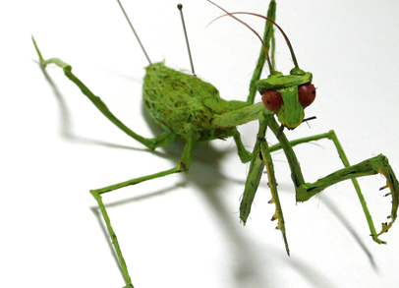
Home Learning Project Year 7
Bugs Life
Investigating the creepy crawlies!
As you are exploring this topic for your current project at school we would like you to further extend your learning at home. As part of this you have been tasked with creating imaginative artwork of your choice …

Slide 2
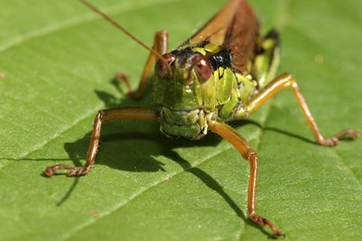
Choose one of the
following options:

Slide 3
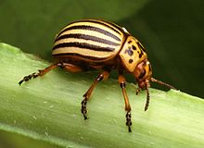
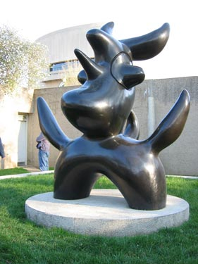
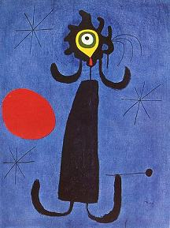
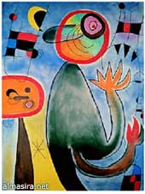
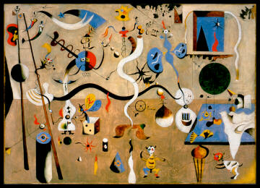
Invent a new imaginary bug! Create a hybrid creature from your own imagination
For example Juan Miro created surreal creatures based on his dreams and vivid imagination. What could your dream up?
It could be a painting, sculpture or 2D relief piece. Make this no bigger than A3 or 30cm high
Strange
Unusual
Fantasy
Surreal

Slide 4
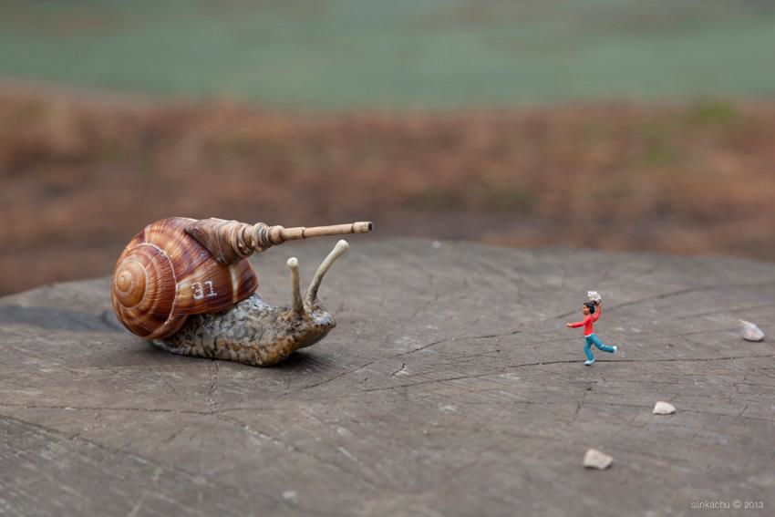
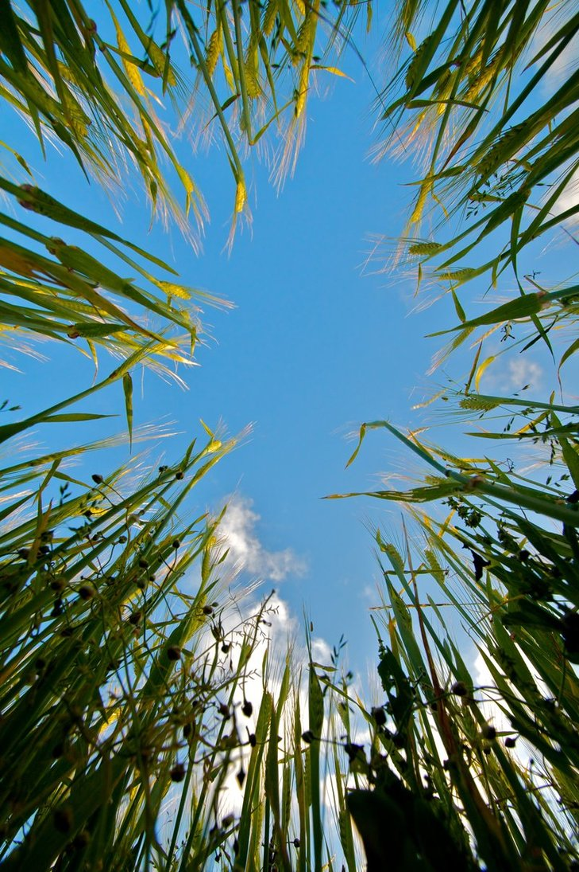
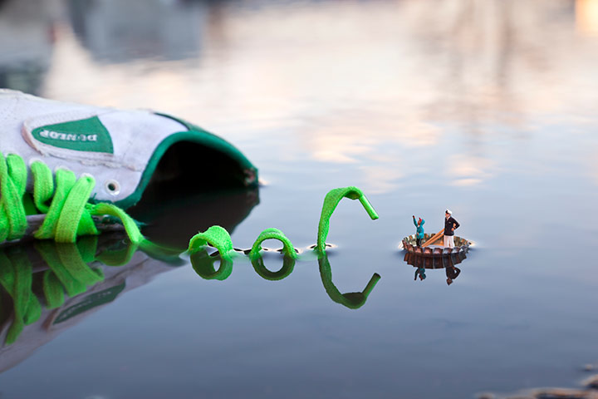
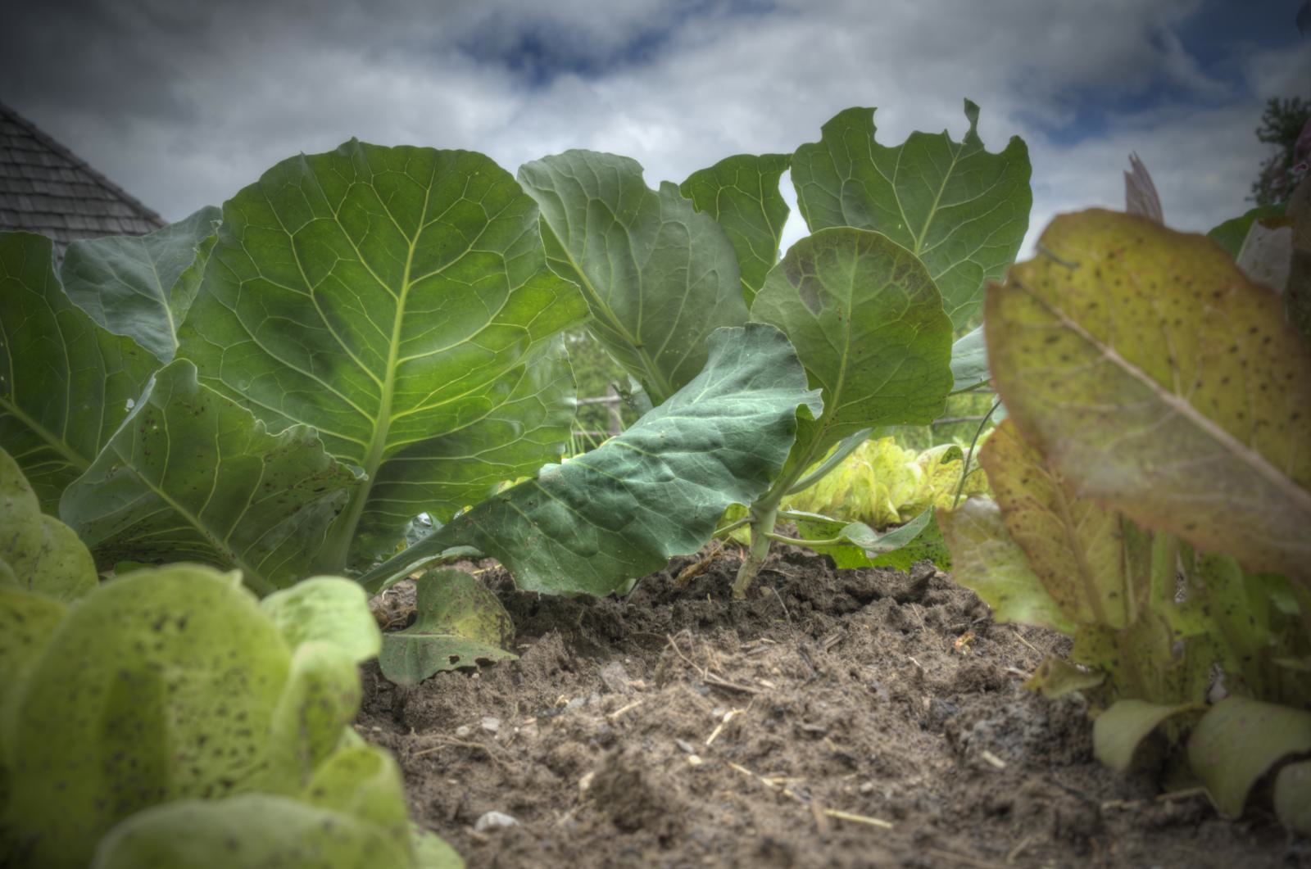
Create a series of photographs from a Bugs ‘point of view’.
Imagine you are in a bugs shoes and looking at life from the perspective of a small insect. What would the world look like? Take inspiration from tilt shift photography and a group of photographers called ‘Slinkachu’…

Slide 5
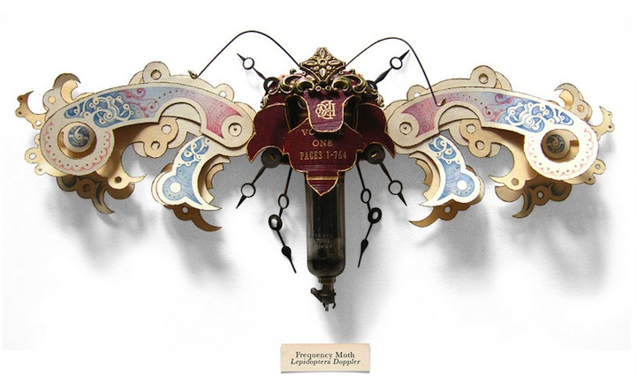
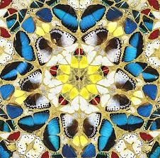
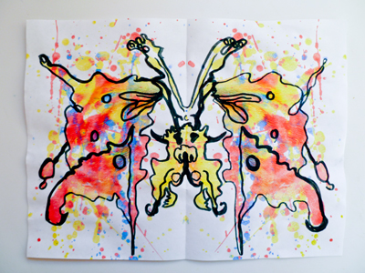
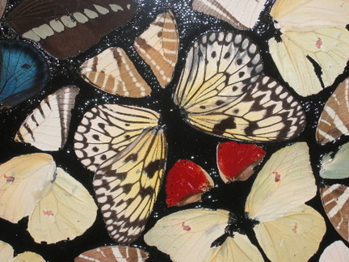
Create a unique creepy crawly drawing, painting or sculpture.
Anything goes! You can use photography or, make a collage, make a sculpture- work in any material you choose and on any size You could use techniques you have learnt in your lessons at school!
Damien Hirst
repeated
collaged
mirrored

Slide 6
You have 6 weeks (including holidays) to complete this task. You can get your family/friends involved in helping you if you want, too.
DEADLINE: 28/29/30 June 2018
You must remember that you have been given a number of weeks to do this work so it must look as if it has taken you some time. You should spend
1 hour per week on this project until it is due in.
You will be asked to bring in your project every other week for a progress check if you do not bring in your work you will receive a note/phone call home, so REMEMBER to bring your work in!

